Slide 1
Design Sprint 3
Jamel Douglas, Jack Miller, Logan Smith

Slide 2
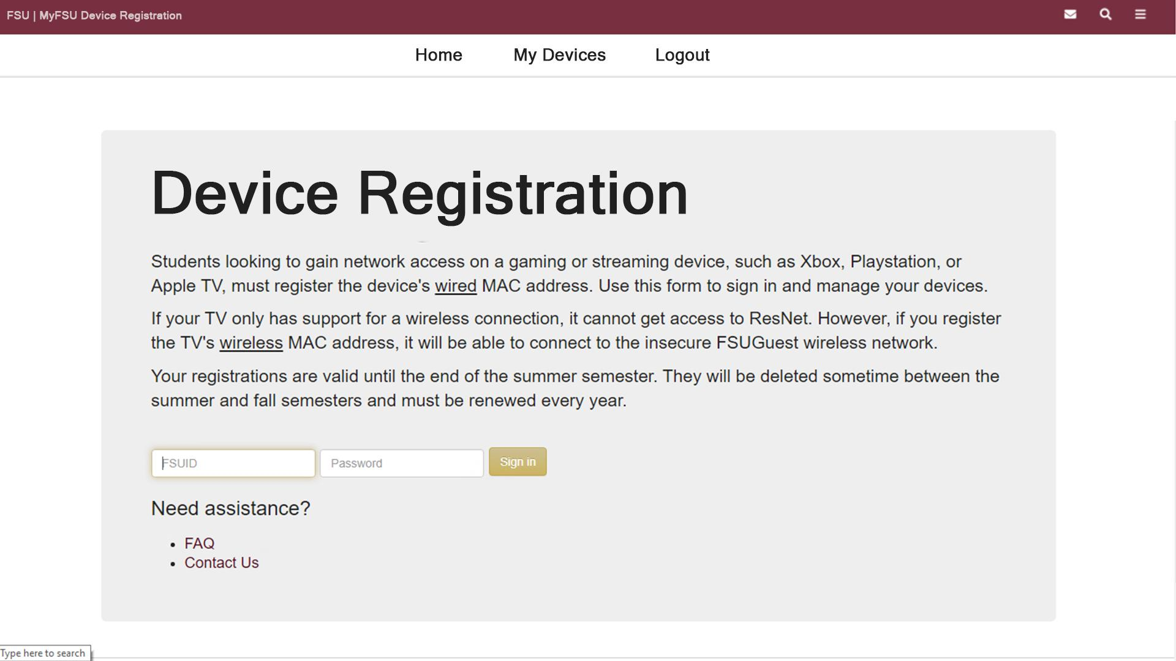

Slide 3
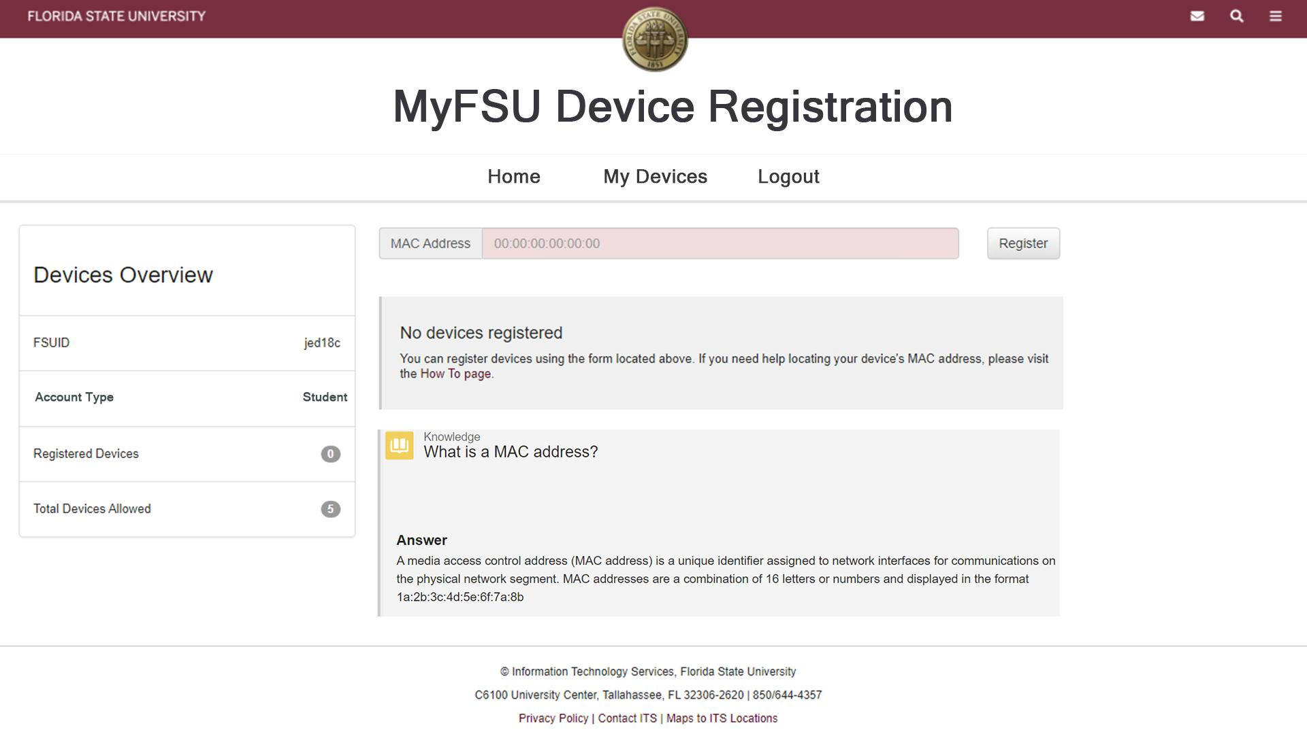

Slide 4
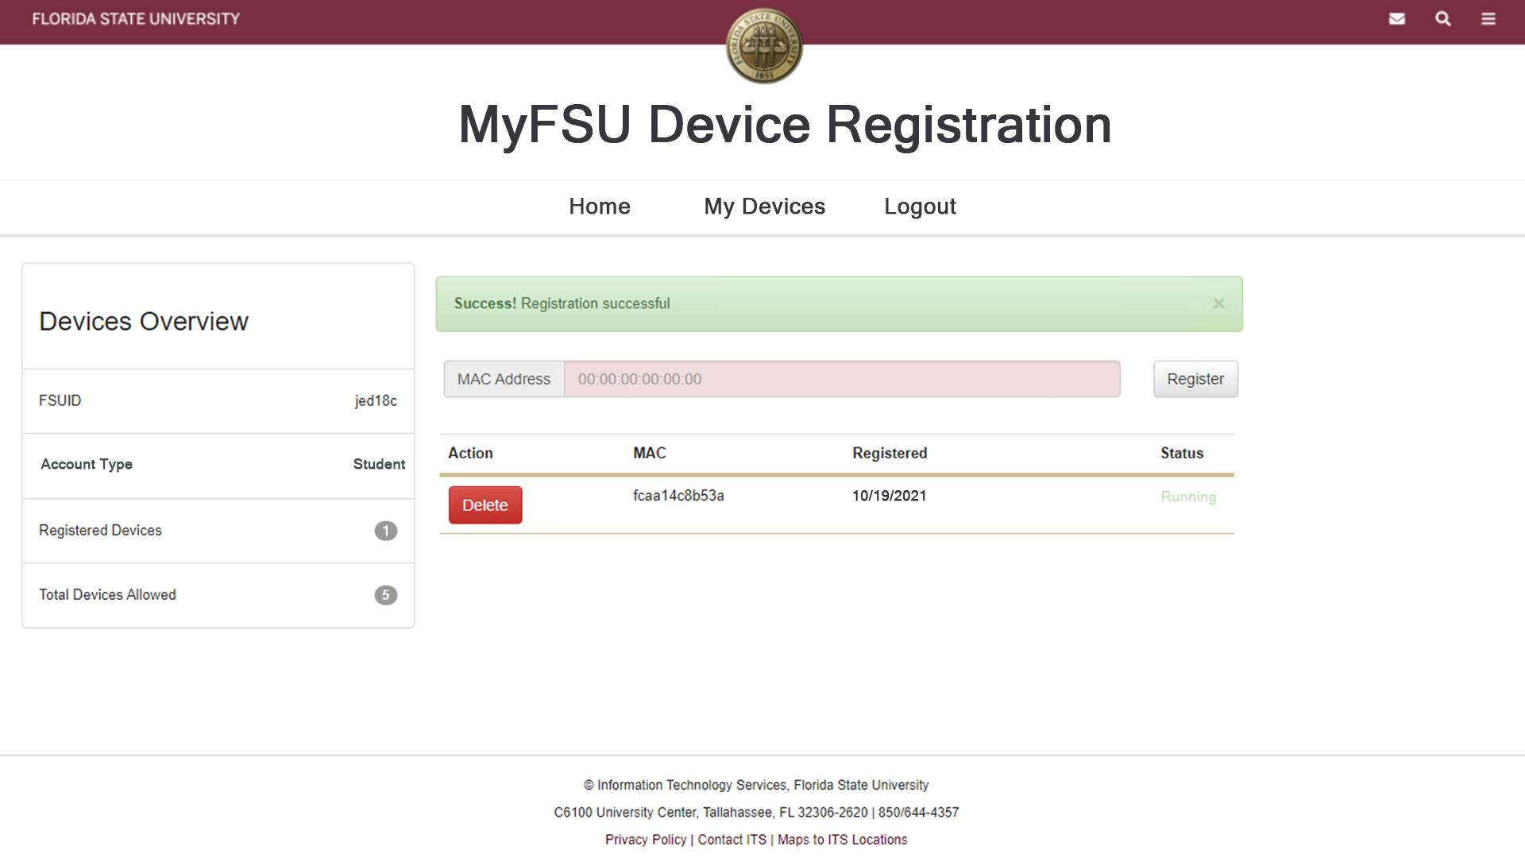
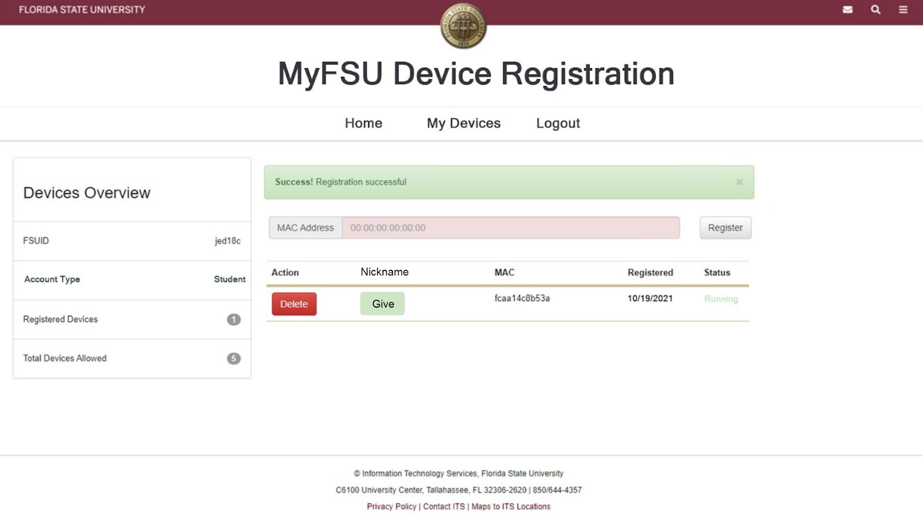

Slide 5
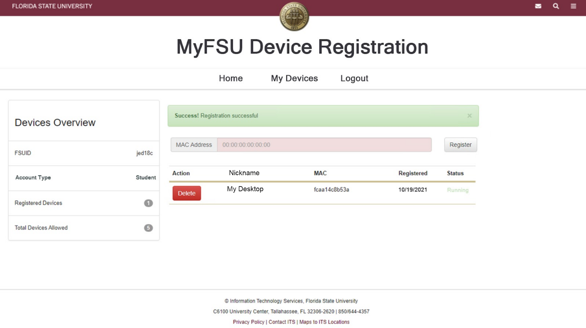

Slide 6
?
Combine CamReg and ResReg into one system.
Network Team should have backend access to this system as they will be maintaining it. When a user submits a MAC address, this service will run a script that will run the commands necessary to give users access to the internet.
Identifying the type of devices is not entirely necessary for the network team, but each user should have a way to know what MAC address belongs to a certain device
Link to FAQs on the login page leads to a page that no longer exists.

